Slide 1
OSNA SIMETRIJA

Slide 2
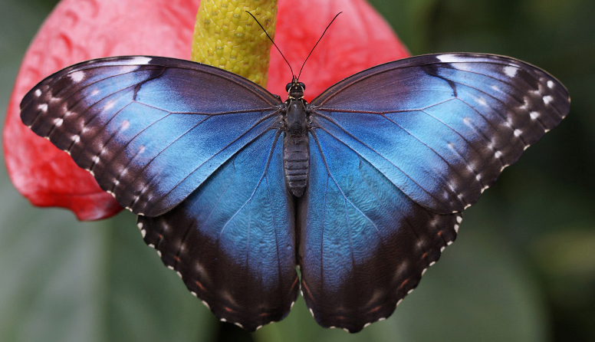
PREUZETO: https://hr.izzi.digital/DOS/45405/74091.html (18.3.2024.)

Slide 3
PREUZETO: https://hr.izzi.digital/DOS/45405/74091.html (18.3.2024.)

Slide 4
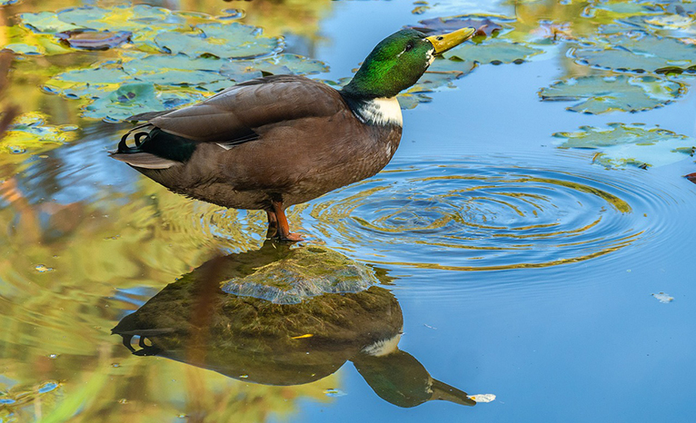
PREUZETO: https://hr.izzi.digital/DOS/45405/74091.html (18.3.2024.)

Slide 5
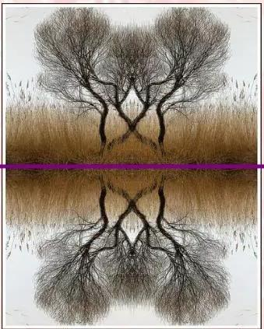
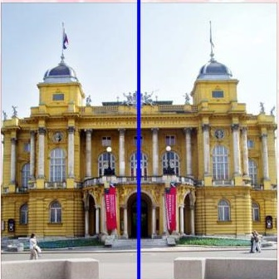
PREUZETO: https://www.slideserve.com/leia/osna-simetrija (18.3.2024.)

Slide 6
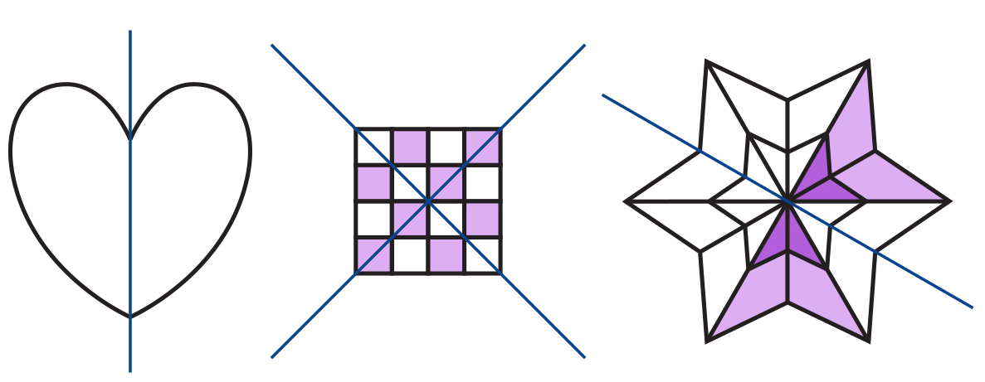
PREUZETO: https://edutorij-admin-api.carnet.hr/storage/extracted/2259307/html/201_osnosimetricno_i_centralnosimetricno_preslikavanje_skupova_tocaka_u_ravnini.html (18.3.2024.)

Slide 7
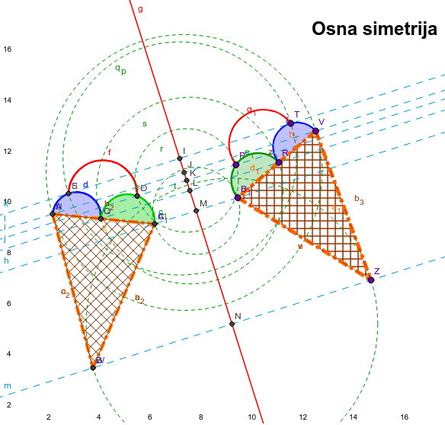
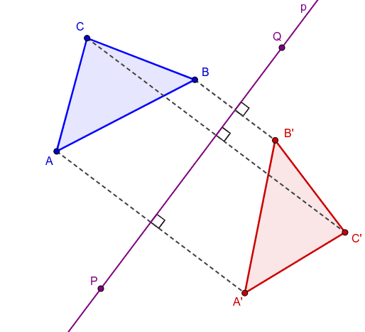
PREUZETO:https://www.geogebra.org/m/UTZWzCEj
https://www.geogebra.org/m/s2qfdxkn (18.3.2024.)

