Slide 1
Centralna simetrija

Slide 2
PREUZETO: https://hr.izzi.digital/DOS/45405/74092.html (18.3.2024.)
https://www.slideserve.com/vernon-rowland/geometrija-u-prirodi (18.3.2024.)

Slide 3
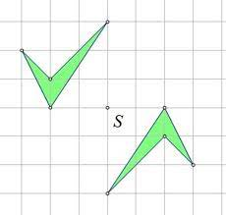
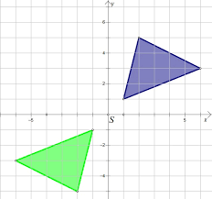
PREUZETO: https://edutorij-admin-api.carnet.hr/storage/extracted/653895/html/4874_Centralna_simetrija.html (18.3.2024.)

